Slide 1

The Technology Value Stream
Optimizing for Rapid Deployment
Ryan Norrbom
CSD 380 - Assignment 1.2
August 18th, 2024
Notes:
In this presentation, we will explore the concept of the technology value stream and how it can be optimized for rapid deployment. We will discuss the differences between lead time and processing time, the common scenario of deployment lead times requiring months, and the DevOps ideal of deployment lead times of minutes.

Slide 2

Overview
Technology Value Stream
The technology value stream is an all-encompassing process that includes ideation, development, testing, and deployment of software to more efficiently deliver value to customers and businesses.
Optimizing Value Stream
When optimized the technology value stream can reduce lead times and increase the frequency of deployments, delivering more value, faster.

Slide 3

Understanding Lead Time vs. Processing Time
Lead time and processing time are two essential metrics in the value stream that can help identify areas for improvement. Lead time is the time it takes from initiating a request to delivering the final product, while processing time is the time it takes to complete the work on an individual request.

Slide 4
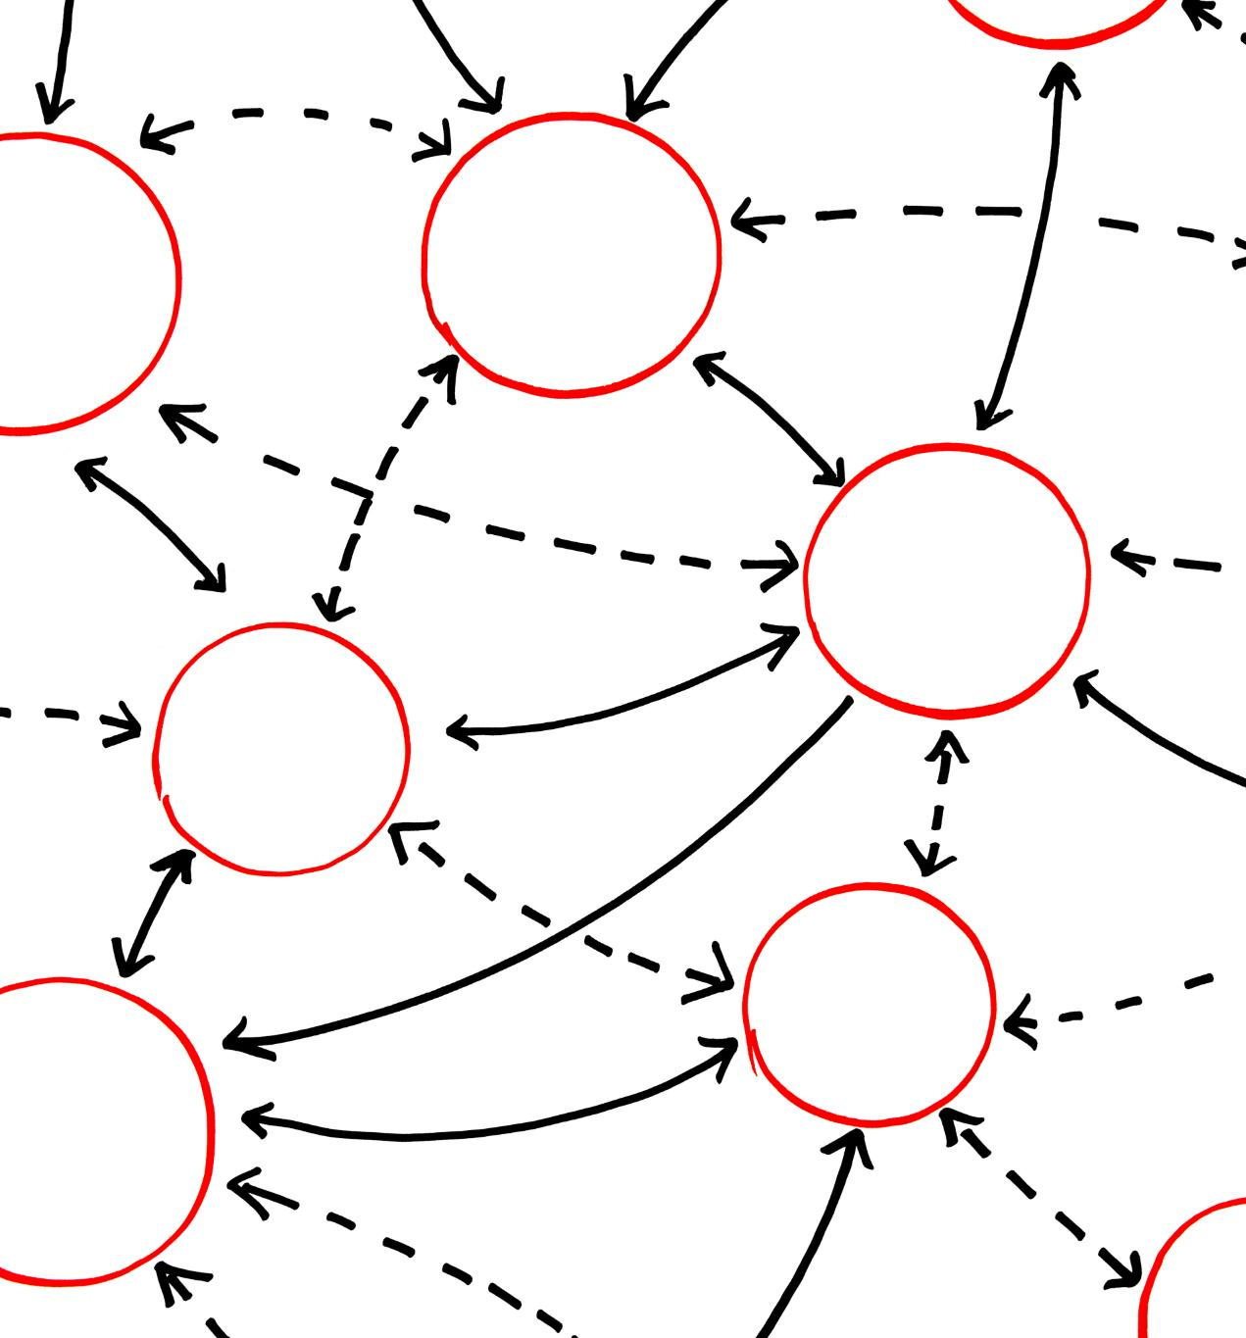
The Common Scenario: Deployment Lead Times Requiring Months
Traditional Approach to Software Delivery
Normal software delivery and deployment lead times can take months, leading to delays and frustration for both customers and developers, especially if they are not predictable and on-schedule.
Optimizing the Value Stream
An optimized value stream with DevOps can reduce deployment lead times to deliver value faster, more frequently, and on time.

Slide 5

Our DevOps Ideal: Deployment Lead Times of Minutes
DevOps Ideal
The DevOps ideal is to achieve deployment lead times of minutes, enabling teams to deliver value to customers quickly and reliably.
Continuous Integration
Continuous integration is a DevOps practice where developers frequently integrate code changes into a shared repository. This helps identify and fix conflicts and issues early in the development process.
Continuous Deployment
Continuous deployment is a DevOps practice in which code changes are tested using automated tools and deployed to production systems.

Slide 6

Achieving Rapid Deployment
Automated Testing
Automated testing is a practice that involves using software tools to run tests automatically instead of relying on manual testing. This enables teams to catch errors earlier and ensure the software works as expected.
Infrastructure as Code
Infrastructure as Code is managing IT infrastructure using code and software development techniques. This can help teams automate resource deployments and reduce the risk of errors and inconsistencies.
Containerization
Containerization is the practice of packaging software code and dependencies into containers, which can then be run on any platform or environment. This set up teams to save time and reduce the risk of conflicts or compatibility issues.

Slide 7

Continuous Improvement
Continuous improvement is a key aspect of the DevOps approach, as it allows teams to review and look for optimization opportunities in the value stream regularly. This allows teams to identify areas for improvement and implement changes to optimize the flow of value to customers.

Slide 8

Key Takeaways
Technology Value Stream
The technology value stream encompasses the entire software delivery process, from ideation to deployment.
DevOps Principles
By optimizing the value stream with DevOps principles, we can reduce deployment lead times to minutes, enabling teams to deliver value quickly and reliably.
Automated Testing
Automated testing is a practice for achieving rapid and reliable software delivery.
Infrastructure as Code
Infrastructure as code is a methodology to manage infrastructure like they manage code, enabling reproducible, automated, and scalable infrastructure management.

Slide 9
Thank you

Slide 10
References
Kim, G., Debois, P., Willis, J., Humble, J., Forsgren, N., & Allspaw, J. (2021). The devops handbook: How to create world-class agility, reliability, & Security in Technology Organizations. IT Revolution Press, LLC.

Slide 11
GitHub
https://github.com/GeraltOfCodea/csd-380

